Slide 1

System Programming and Operating System
18BTIS502/18BTCS502
Compiled by –
Dr. Jyoti Malhotra & Prof. Pranav More
SPOS – subject incharge
Department of CSE
MIT School of Engineering, MIT ADT University
Pre-requisite : A very good and strong understanding of the C Programming language (esp. pointers) & Computer Organization

Slide 2

Course Objectives
To understand basics of System Programming.
To learn and understand data structures used in design of system software.
To understand functions of operating system.
To learn and understand process, resource and memory management.

Slide 3
Course Outcomes
Analyze and synthesize system software
Understand the working of Assemblers and Macroprocessors
Understand the functions of operating system.
Do the programming for process and thread management in OS

Slide 4
System Programming and Operating System 18BTIS502
Introduction to Systems Programming
Introduction to Macro Processors
Introduction to Operating System & Process Management
Memory Management
I/O and File Management
References- Systems Programming and Operating Systems, D.M. Dhamdhere and Internet resources)

Slide 5

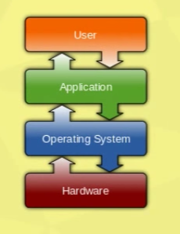
3. Introduction to Operating System & Process Management
Introduction to Operating Systems
Process
Threads
Scheduling
Mutual Exclusion
Deadlock & Starvation
Image courtesy: www.howtogeek.com; windows; Macintosh ; Android; Linux

Slide 6
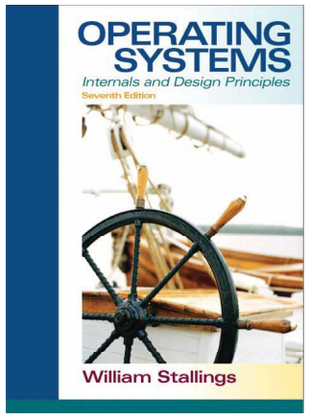

References- Operating Systems: Internals and Design Principles, Seventh Edition, by William Stallings and Internet resources)

Slide 7

Operating System
https://www.youtube.com/watch?v=GjNp0bBrjmU
An operating system is system software that manages computer hardware, software resources, and provides common services for computer programs [Wikipedia]
Operating systems INTERFACE the machine with the application programs.
Main function - Dynamically allocate the shared system resources and execute the programs.

Slide 8
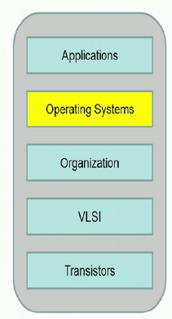
System layers:
Manages execution of applications and resource management
The layers in the system :
Physical Hardware
Organized into Memory, RAM, Decode unit, Instruction fetch, etc
Composed together to build
several logical Gates; Memory cells, flip flops, registers, etc
System Layers : NPTEL; course on Operating system

Slide 9
Operating System
OS is a Resource Allocator
Manages all resources.
Decides between conflicting requests for efficient and fair resource use.
OS is a Control Program
Controls execution of programs to prevent errors and improper use of the computer.
“The one program running at all times on the computer” is the kernel.
Everything else is either
a system program (ships with the operating system) , or
an application program.

Slide 10

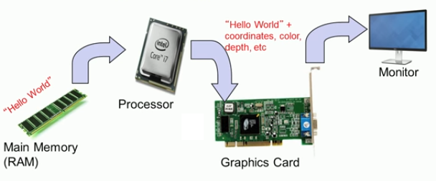
What is the output of the following program?
#include <stdio.h>
int main(){
char str[] = “Hello World\n”;
printf(“%s”, str);
}

Slide 11
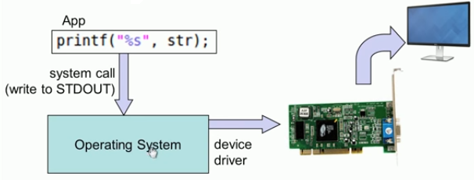
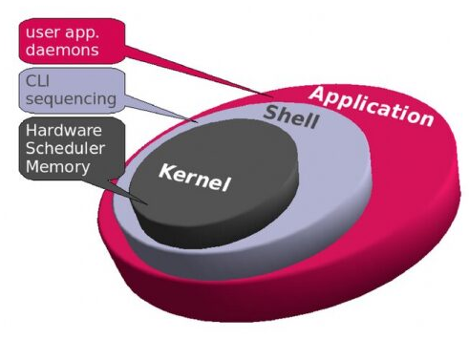
System call and Kernel
Kernel tasks:
Process management
Device management
Memory management
Interrupt handling
I/O communication
File system
write()
System call is the programmatic way in which a program requests a service from the OS kernel.
Kernel - Nervous system of OS
A Kernel is the central part of an operating system.
Kernel manages the operations of the computer and the hardware - most notably memory and CPU time.

Slide 12
$ gcc test.c
$ ./a.out
Enter the input:
9 9
Sum – 18
$

Slide 13

User space : (Sand-boxing)
User space is that set of memory locations in which user processes run.
Kernel manages individual user processes within this space and prevents them from interfering with each other.
Programs (init and a shell); Libraries (libc); Configuration files in /etc; Device nodes in /dev; and User data in /home
Regions of System Memory
Kernel space
Space where kernel executes and provide its services.
Kernel space can be accessed by user processes only with system calls.
It is reserved for the highest of trusted functions within a system.
Any instability within the kernels executing code can result in complete system failure.
User space (sand – boxing)
Kernel space
The system starts in kernel mode when it boots and after the operating system is loaded

Slide 14
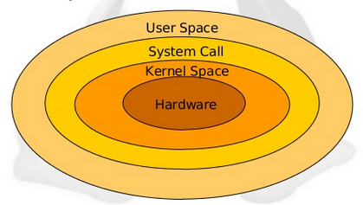
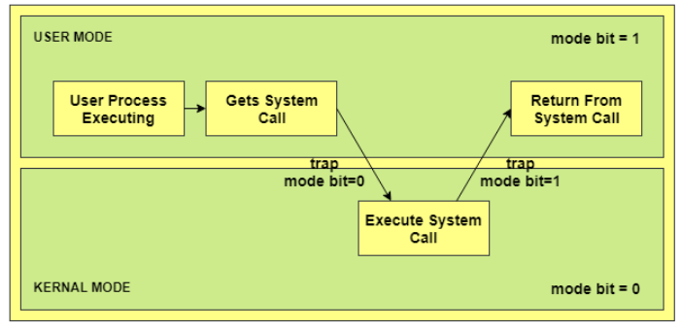
User mode vs Kernel mode
Transition from user mode to kernel mode and back again
The system is in user mode when OS is running a user application such as handling a text editor.
The transition from user mode to kernel mode occurs when the application requests to OS or an interrupt or a system call occurs.
The mode bit is set to 1 in the user mode. It is changed from 1 to 0 when switching from user mode to kernel mode.
User space is less-privileged mode

Slide 15
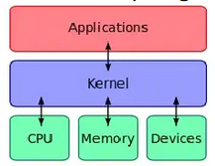
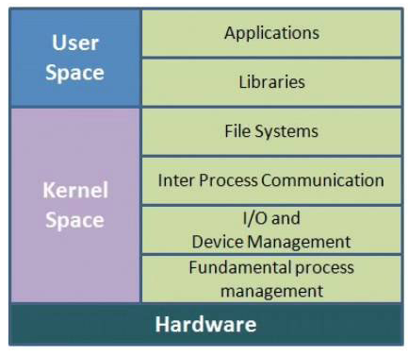
Kernel types
Monolithic
Entire OS runs in a kernel space
It is fast; difficult to add new facilities
No part of OS runs in user space
Larger in size.
Linux
MONOLITHIC
MICRO KERNEL
HYBRID
Image courtesy: google search

Slide 16
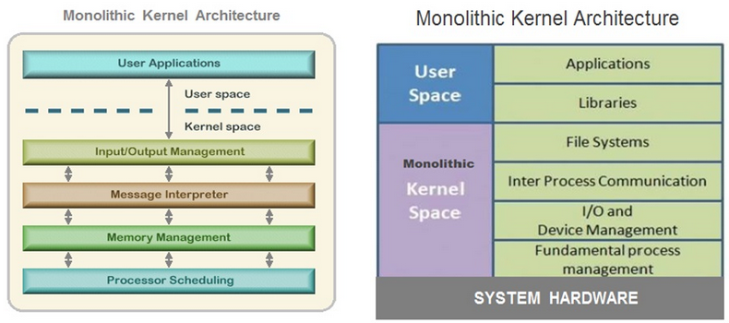
Monolithic
Image courtesy: google search

Slide 17
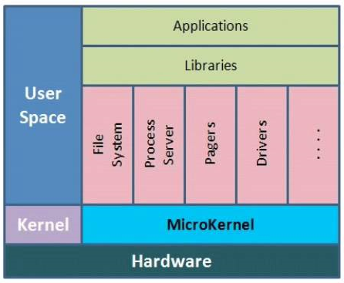
Kernel types
Microkernel
User services and kernel services are implemented in different address space.
Reduces the size of kernel and OS
It is slow; easy to add new facilities
Responsible for important OS services such as – Process communication, memory management, CPU scheduling.
Symbian, Windows
Image courtesy: google search

Slide 18
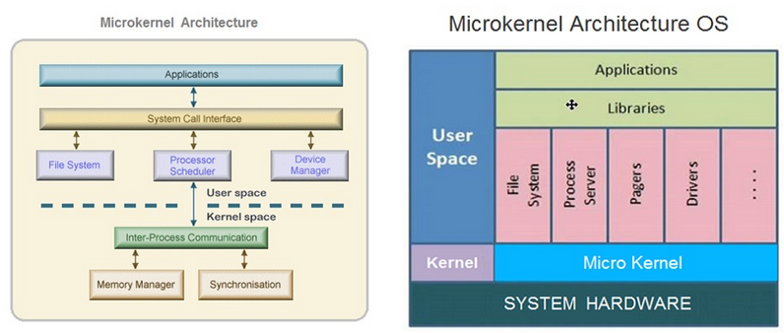
Microkernel

Slide 19
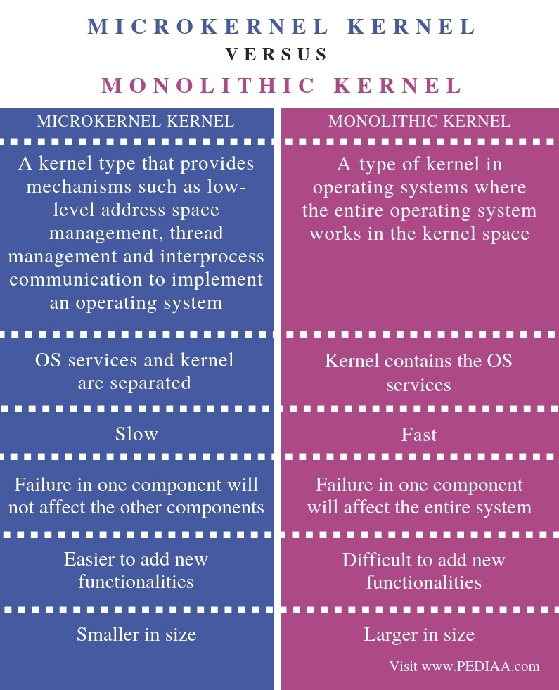
Notes:
Other source : https://www.geeksforgeeks.org/monolithic-kernel-and-key-differences-from-microkernel/

Slide 20
Kernel types
Hybrid
Combines speed of monolithic and stability of microkernel
Mac OS, Windows
OS types:
CLI – Command Line Interface
Allows direct command entry
GUI – Graphical User Interface

Slide 21
System calls
Programming interface to the services provided by the OS.
Typically written in a high-level language (C or C++).
Perform low-level operations.
Mostly accessed by programs via a high-level Application Programming Interface (API) rather than direct system call use.
Most common APIs
Win32 API for Windows
POSIX [Portable OS for UNIX] API for POSIX-based systems (UNIX, Linux, and Mac OS X), and
Java API for the Java virtual machine (JVM)

Slide 22
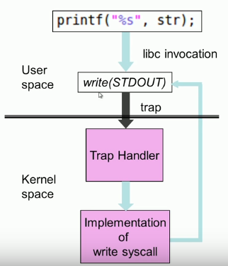
System Call – OS Relationship
Invokes a function in a kernel using a trap.
TRAP always jumps to a fixed address (based on the architecture)
Six categories of the system calls:
Process control
File Management
Device Management
Information Management
Communication
Protection

Slide 23
System call categories:
Process control
Create process, terminate process
end, abort
load, execute
get process attributes, set process attributes
wait for time, wait event, signal event
allocate and free memory
Dump memory if error
Debugger for determining bugs, single step execution
File management
create file, delete file
open, close file
read, write, reposition
get and set file attributes
Device management
request device, release device
read, write
get device attributes, set device attributes
logically attach or detach devices

Slide 24
System call categories:
Information maintenance
get time or date, set time or date
get system data, set system data
get and set process, file, or device attributes
Communications
create, delete communication connection
send, receive messages through message passing model (client to server) or shared-memory model
transfer status information
attach and detach remote devices
Protection
Control access to resources
Get and set permissions
Allow and deny user access

Slide 25
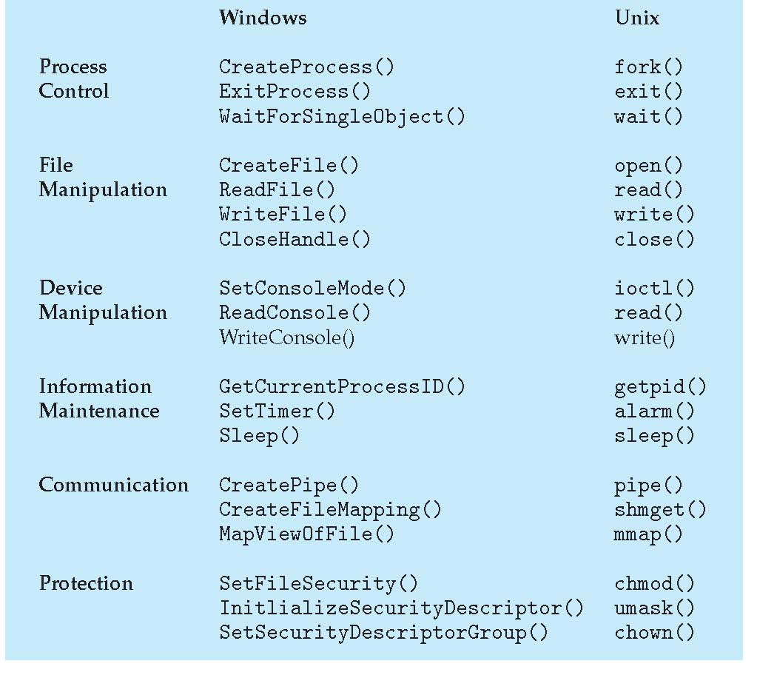
Examples of Windows & Unix System Calls

Slide 26

Process Management
Process concepts
Process states
Process description and process control

Slide 27
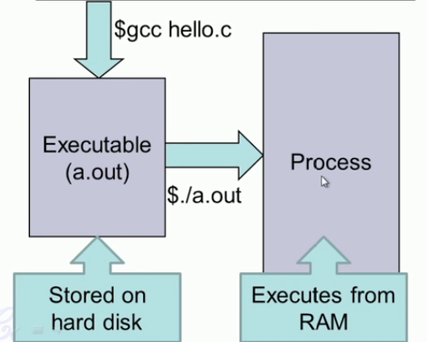
PROCESS
Process is a program in execution
Present in the RAM
Comprises of
Executable instructions
Stack
Heap
State in the kernel
State contains: registers, list of open files, related processes, etc.
i.e. Program code and set of data.
#include <stdio.h>
int main(){
char str[] = “Hello World\n”;
printf(“%s”, str);
}
A process is named using its process ID (PID)

Slide 28
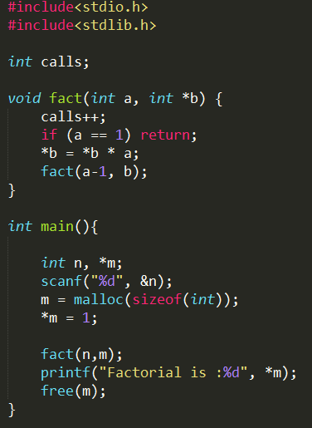
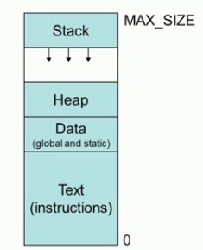
PROCESS Memory Map
Notes:
1.Stack
The process Stack contains the temporary data such as method/function parameters, return address and local variables.
2 Heap
This is dynamically allocated memory to a process during its run time.
3 Data
This section contains the global and static variables.
4 Text
This includes the current activity represented by the value of Program Counter and the contents of the processor's registers.

Slide 29
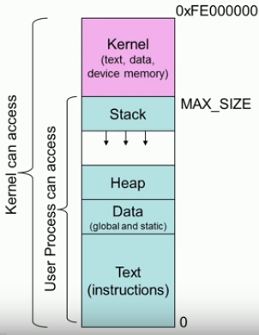
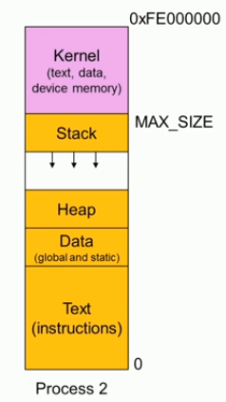
Beyond the process memory map

Slide 30
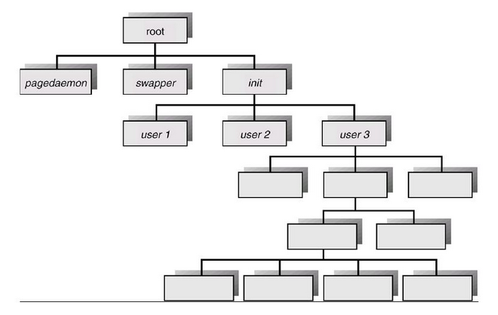
Process tree on Unix system

Slide 31
Process Creation
A process may be CREATED in the system for different operations like –
User request for process creation (log in, printer access, skype, etc)
System Initialization; created by OS to initiate some service.
Execution of a process creation system call by a running process.
Parent process creates children processes, which, in turn create other processes, forming a tree of processes.
Parent process
Child processes

Slide 32
Process Creation
Resource sharing–
Parent and children share ALL resources.
Children share SUBSET of parent’s resources.
Parent and child share NO resources.
Execution–
Parent and children execute concurrently.
Parent waits until children terminate.
Address space–
Child duplicate of parent.
Child has a program loaded into it.

Slide 33
Process Termination
Process termination occurs when the process is terminated.
The exit() system call is used by most operating systems for process termination.
User can terminate execution of another processes (kill).
Causes of process termination-
After its execution
A child process may be terminated if its parent process requests for its termination.
If a parent process is terminated, then its child processes are also terminated.
I/O failure; Arithmetic error; Data misuse
Unavailable memory required for the process

Slide 34
Process Life Cycle (Process States)
As a process executes, it changes state.
Each process may be in one of the following states.
NEW
The process being created.
READY
The process has all the resources available & is waiting to be assigned to a processor.
RUNNING
Process Instructions are being executed.
WAITING
The process is waiting for some event to occur (I/O event, timer/trigger)
TERMINATED
Process has finished its executed.
Notes:
Processes may be in one of 5 states, as shown below.
New - The process is in the stage of being created.
Ready - The process has all the resources available that it needs to run, but the CPU is not currently working on this process's instructions.
Running - The CPU is working on this process's instructions.
Waiting - The process cannot run at the moment, because it is waiting for some resource to become available or for some event to occur. For example the process may be waiting for keyboard input, disk access request, inter-process messages, a timer to go off, or a child process to finish.
Terminated - The process has completed

Slide 35
Process States – 5 state model
Admit
Dispatch
Release
NEW
READY
RUNNING
TERMINATE
Time-out
Event
Occurs
Event
Wait
WAITING

Slide 36
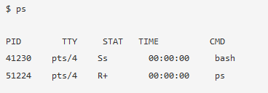
Process States- Linux
R Running or Ready
S Interruptible sleep (waiting for an event to complete)
Z A defunct (“Zombie”) process
O Orphan state
T Stopped
D Uninterruptible Sleep (IO)
+ foreground process
s Session leader

Slide 37
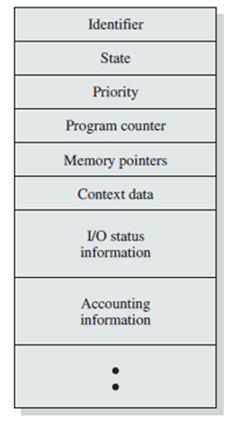
Process Control Block (PCB) A Data Structure for every process
Every process is uniquely characterized by several elements.
Each process is represented in the operating system by a PCB.
PCB is also called as Task Control Block (TCB)
Information associated with PCB-
Process state
Process number
Program counter
CPU registers (Context data)
CPU scheduling information
Memory-management information
I/O information (open files)
Accounting information

Slide 38
Process Control Block (PCB) The PCB is identified by an integer process ID (PID)
Process ID | Unique identification for each of the process in the operating system.
Process State | The current state of the process i.e., whether it is ready, running, waiting, etc
Priority | Priority level relative to other processes.
Program Counter | The address of the next program instruction to be executed.
Memory pointers | Pointers to program code and data associated with the process.
Context data (CPU registers) | Data present in CPU registers while the process is executing.
I/O status information | I/O requests, I/O devices, a list of files in use by the process.
Accounting information | Amount of processor time and clock time, time limits, etc.

Slide 39
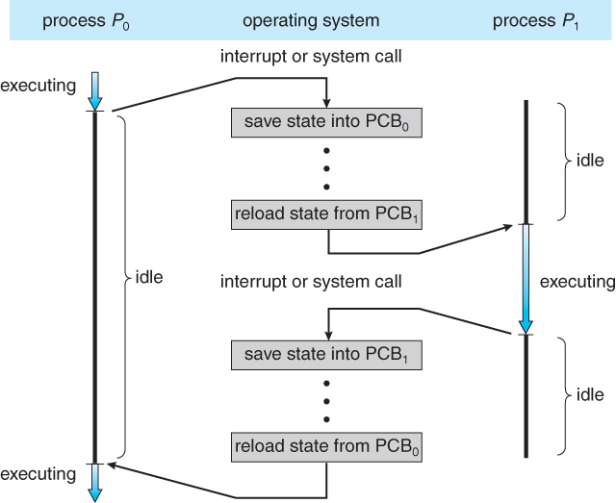
CPU Switch from process to process

Slide 40
Process Creation – Unix/Linux
fork()
System call used to create new processes.
It takes no arguments and returns a process ID.
Return value of fork() - pid_t defined in sys/types.h
Negative | The creation of a child process was unsuccessful.
Zero | Is returned to newly created child process
Positive | Value is the process ID of the child process, and it is returned to the parent.
Process can use function getpid() to retrieve the process ID assigned to this process.

Slide 41
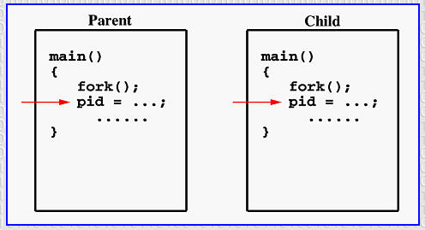
Process Creation – fork()
If the call to fork() is successful, Unix
Creates 2 identical copies of address spaces, one for the parent and the other for the child.
Both processes will start their execution at the next statement following the fork() call.
cid- Child ID
cid
cid

Slide 42
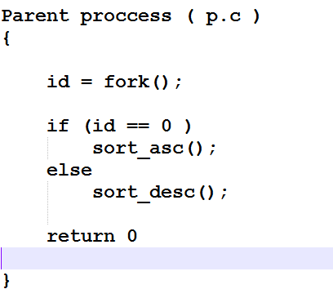

Slide 43
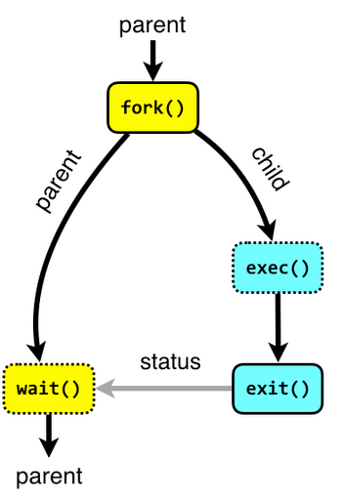
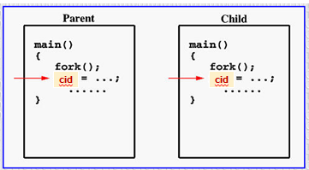
Process Creation – fork()
Both processes start their execution right after the system call fork().
As both processes have identical but separate address spaces, variables initialized before the fork() call have the same values in both address spaces.
Since every process has its own address space, any modifications will be independent of the others.
exec() system call used after a fork() to replace the process’ memory space with a new program
Notes:
http://www.it.uu.se/education/course/homepage/os/vt18/module-2/process-management/

Slide 44
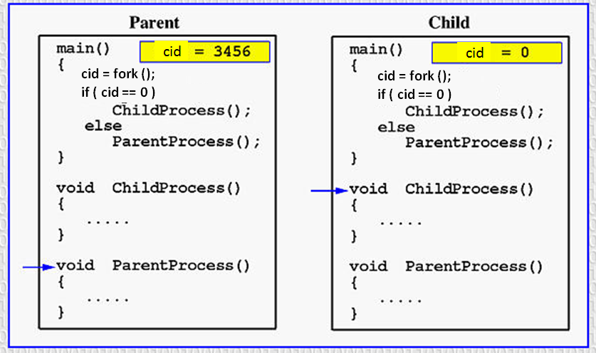
Process Creation – fork()
For child process: getpid() is 3456 and getppid() is say 3454
Notes:
Getpid – get process id
Getppid – get parent process id

Slide 45
System calls
fork()
fork - create a child process
#include <sys/types.h>
#include <unistd.h>
pid_t fork(void);
Creates a new process by duplicating the calling process.
The new process is referred to as the child process.
Returns the ID of the child process.
The calling process is referred to as the parent process.
The child process and the parent process run in separate memory spaces.

Slide 46
Fork template
int main(){
char str[20];
int arr[MAX];
pid_t cid;
accept_str(str);
accept_nos(arr);
cid = fork();
if( cid == 0 ) {//CHILD PROCESS
sort_desc(arr);
cnt_words(str);
}
else {
sort_asc(arr);
cnt_vowels(str);
}//end of if-else
return 0;
}//end of main
Notes:
Parent process - sorts array elements in ascending order
- Count number of vowels in the given sentence
Child process - sorts array elements in descending order
- Count number of words in the given sentence

Slide 47
System calls
sleep() - sleep for a specified number of seconds
#include <unistd.h>
unsigned int sleep(unsigned int seconds);
Causes the calling thread/process to sleep either until the number of real-time seconds specified in seconds have elapsed or until a signal arrives which cannot be ignored.
Uninterrutable
Returns - Zero if the requested time has elapsed, or the number of seconds left to sleep, if the call was interrupted by a signal handler.

Slide 48
System calls
getpid() - get process identification
getppid() - get Parent process identification
#include <sys/types.h>
#include <unistd.h>
pid_t getpid(void);
pid_t getppid(void);
getpid() returns the process ID (PID) of the calling process.
getppid() retuns the Parent PID of the calling process.

Slide 49
System calls
wait() - wait for process to change state
#include <sys/types.h>
#include < sys/wait.h >
pid_t wait(int *status);
The wait() system call suspends execution of the calling process until one of its children terminates.
It waits for the exit status of child process terminating with PID collected in pid_t.

Slide 50
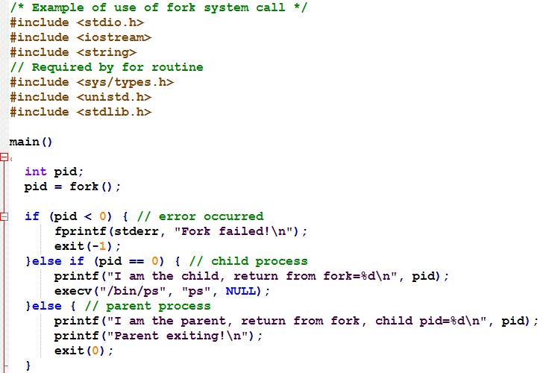
fork() example
execve() executes the program pointed to by filename. filename must be either a binary executable, or a script starting with a line of the form:
execve() does not return on success, and the text, data, and stack of the calling process are overwritten by that of the program loaded.
NEGATIVE
POSITIVE

Slide 51
2 layers of processes
Two “layers” for processes
Lowest layer of process - structured OS handles interrupts, and process scheduling
Above that layer are sequential processes
Processes tracked in the process table
Each process has a process table entry
Processes
0
1
…
N-2
N-1
Scheduler

Slide 52
Threads
Processes and Threads
Concept of Multithreading
Types of Threads
Thread programming Using pthreads (POSIX threads)

Slide 53
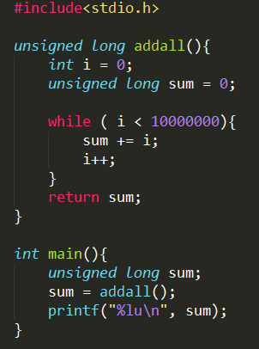
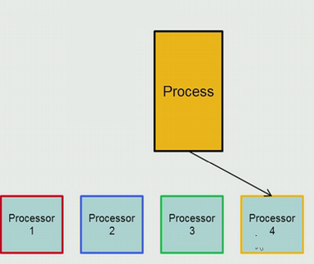
Process
Just runs on a single processor.
The execution time of this entire program will be quite large.
Sum of 1 to 10 million numbers

Slide 54
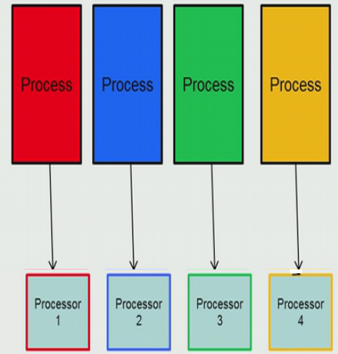
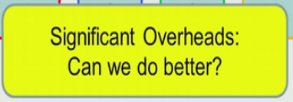
Speeding up multiple processes
4 times faster;
OVERHEAD -
4 system calls (fork()) needed.
Each process is isolated from each other.
Inter-process communication needed – more system calls.
Process management with system calls.
Each process has its own memory map – its own instructions, stack, heap, data, etc.
Create 4 processes; each loop does 1/4th work

Slide 55
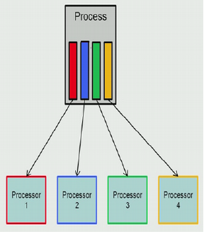
Thread model
1 system call (fork()) needed.
4 threads need to be created; lighter.
Each thread is NOT isolated from each others.
Thread management with fewer or no system calls.
Shared instructions, global and heap regions
Each thread has its own stack and register set
Create 1 process with 4 threads; each loop does 1/4th work

Slide 56
Threads (Parallelism)
A thread is created by a process. (subset of the process)
A thread is a path of execution within a process.
A thread is a flow of execution through the process code; with its own program counter, system registers and stack.
A single process consists of one or more threads.
Light weight process.
Multiple threads share the process instructions, process variables and process state.
Allow a single application to do many things at once.
Example: word processor
Thread to read from keyboard
Thread to format document
Thread to write to disk

Slide 57
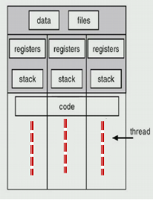
Multithreading
Separate streams of execution within a single process – MULTI-THREADING.
A virtual address space which holds the process image
Each thread state contains -
Registers
Stack
Notes:
Multithreading: The OS supports multiple threads of execution within a single process
Single threading: The OS does not recognize the separate concept of thread
MS-DOS supports a single user process and a single thread
Traditional UNIX supports multiple user processes but only one thread per process
Current UNIX, Solaris and Windows support multiple threads

Slide 58
Threads: “processes” sharing memory
Process == address space
Thread == program counter / stream of instructions
Two examples
Three processes, each with one thread
One process with three threads
Process 1
Process 2
Process 3
Process 1
User space
Threads
Threads
System space
Kernel
Kernel
Multi-threading

Slide 59
Threads & Stacks
Thread 1
Thread 2
Thread 3
User space
Process
Thread 1’s stack
Thread 3’s stack
Thread 2’s stack
Kernel
Each thread has its own stack!

Slide 60
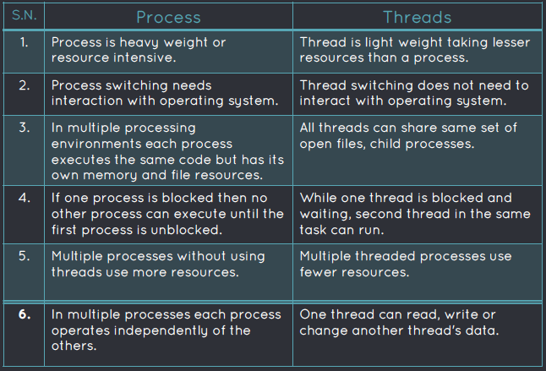
Process vs Threads

Slide 61
Advantages of threads
Thread minimizes context switching time.
Use of threads provides concurrency within a process.
Efficient communication.
Economy- It is more economical to create and context switch threads.
Utilization of multiprocessor architectures to a greater scale and efficiency.
Disadvantages
• Blocking of parent threads will stop all child thread.
• Multithreading - Mutual Exclusion
• Security.

Slide 62
Types of threads
User Level Threads (ULT)
Kernel Level Threads (KLT)
User Level Threads (ULT)
ULT implement in user level libraries.
Thread switching does not need to call operating system and interrupt to the kernel.
The kernel knows nothing about user level threads and manages them as if they were single-threaded process.
Easy to represent and manage.
ULT are fast and efficient and can run on any operating system
1. There is a lack of coordination between threads and OS kernel.
2. Scheduling can be a issue.

Slide 63
Thread library for ULT
Contains code for:
Creating and destroying threads
Passing messages and data between threads
Scheduling thread execution
pass control from one thread to another
Saving and restoring thread contexts
Pthread or win32 library
Common operations
– create/terminate threads
– suspend/resume threads
– priorities and scheduling threads
– synchronization threads

Slide 64
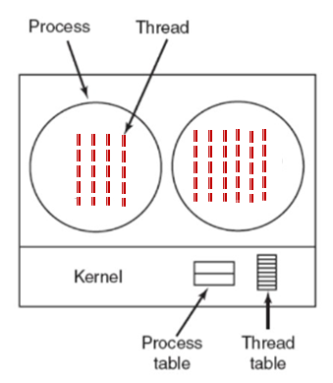
Kernel-Level Threads (KLT) Ex: Windows, OS/2, Unix, Mac
All thread management is done by kernel.
No thread library; instead, an API to the kernel thread facility.
OS kernel provides system call to create and manage threads.
Kernel maintains -
Context information for the process and the threads
Switching between threads
Thread scheduling
Notes:
Advantages:–Scheduler can decide to give more time to a process having large number of threads than process having small number of threads.–Kernel-level threads are especially good for applications that frequently block.•
Disadvantages:–The kernel-level threads are slow (they involve kernel invocations.) –
Overheads in the kernel. (Since kernel must manage and schedule threads as well as processes.

Slide 65
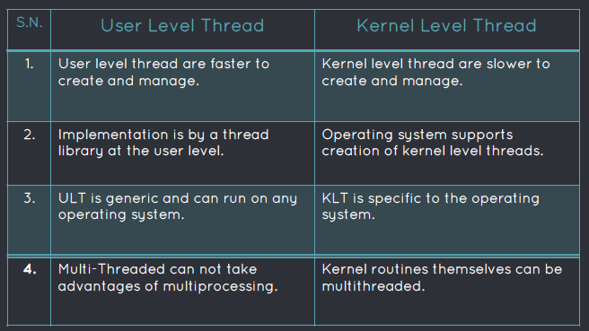
ULT vs KLT

Slide 66
Multithreading models
Many-to-One Model ( Multiple ULTs to 1 KLT)
Fast. No system calls to manage threads.
No parallel execution of threads.
One-to-One Model ( 1 KLT to 1 ULT)
Better suited for multiprocessor environments.
When one thread blocks, the other threads can continue to execute.
Many-to-Many Model ( Multiple ULTs to multiple KLTs)
OS creates kernel threads as required
Notes:
Many-to-One Model :
Implementation of the many-to-one model (many user level thread to one kernel level thread) allow the application to create any number of threads that can execute concurrently. In this implementation, all threads activity is restricted to user space.
Additionally only one thread can access the kernel at a time, so only one schedulable entity is known to the os.
One-to-One Model :
The one-to-one model (one user level thread to one kernel level thread) is among the earliest implementations of true multithreading. In this implementation, each ULT created by the application is known to the kernel,and all threads can access the
kernel at the same time.
Many-to-Many Model :
The many-to-many model (many user level thread to many kernel level thread) avoids many of the limitations of the one-to-one model, while extending multithreading capabilities even further. The manyto-many model also called two-level model, minimize programing effort while reducing the cost and weight of each thread.

Slide 67
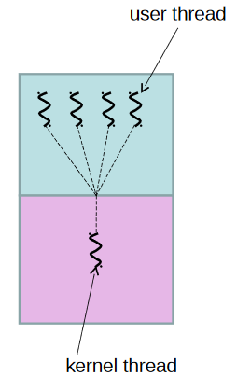
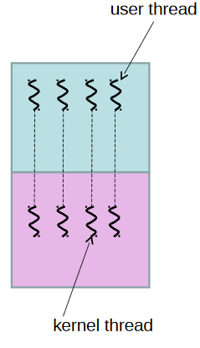
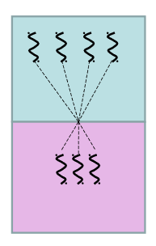
Multithreading models
Many-to-One
One-to-one
Many-to-many

Slide 68
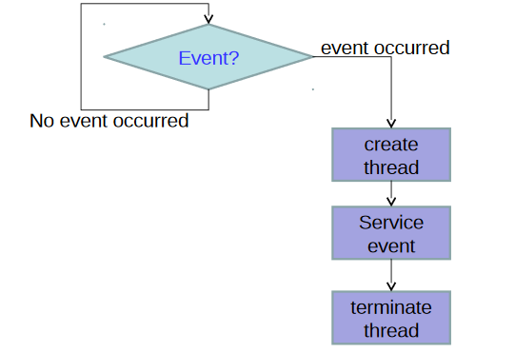
Typical usage of Threads
pthread_create()
Create a new thread
pthread_join()
Waits for thread termination
pthread_exit()
Terminates the calling threads

Slide 69

Recap on Unit 3 journey
Operating System
Kernel types
System Calls
Process
Fork(), sleep(), wait(), execv()
Threads and differences with processes
ULT (pthread) and KLT
Multithreading models

Slide 70

Scheduling
Arranging, controlling and optimizing work
Uniprocessor scheduling algorithms
FCFS, Round robin, SJF, Priority
Concurrency
Requirements for Mutual Exclusion
Image courtesy: Google images

Slide 71
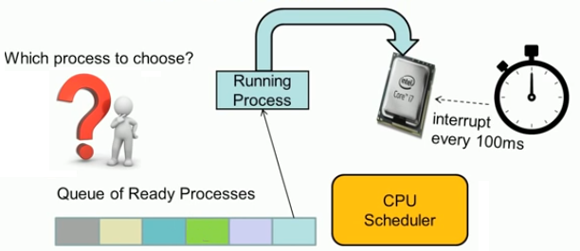
Process Scheduling
Aim - to assign processes to be executed by the CPU; meeting system objectives, such as response time, throughput, and processor efficiency.
Scheduler is triggered to run when new process is created OR interrupt occurs OR when running process is blocked on I/O

Slide 72
Scheduler Types
Long term scheduling
Medium term scheduling
Short term scheduling
Performed when a new process is created.
Select the jobs from the pool of jobs and load these jobs into main memory (Ready Queue)
A process requests an I/O in the middle of execution.
It is removed from MM and is loaded into the waiting queue.
Post I/O operation; It is later dropped to ready queue.
Dispatches a process from the ready queue to CPU for execution.
Invoked when an event occurs like Clock interrupts, I/O interrupts, and Operating system calls
Notes:
Medium-term scheduling is a part of the swapping function.
Short-term scheduling
- is the actual decision of which ready process to execute next.
- Executes most frequently to decide which process to execute next

Slide 73
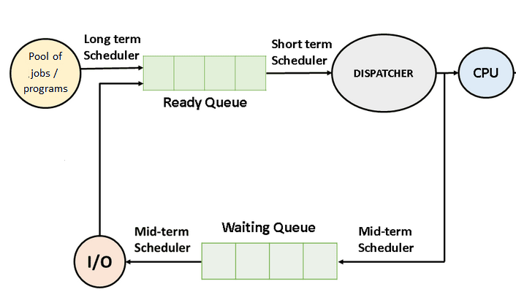
Scheduler Types

Slide 74
Scheduling – Decision modes
Nonpreemptive
Preemptive
Once a process is in the running state, it will continue until it TERMINATES or blocks itself for I/O
Process does not release the resources until its completion.
Algorithms - FCFS, Shortest Job First (SJF basically non preemptive) and Priority (non preemptive version), etc.
CPU can release the process in the middle of execution i.e. the process may be INTERRUPTED and moved to ready state.
Preemption may occur when a new process arrives, on an interrupt, or periodically
Algorithms - Round Robin (RR), Shortest Remaining Time First (SRTF), Priority (preemptive version), etc.

Slide 75
Scheduling Terminologies
Arrival time: Time at which the process enters the ready queue.
Burst time or service time: Time required by the process to get execute on CPU.
Completion time: Time at which the process complete its execution.
Turn around time: Finish time – Arrival time i.e. time from start to completion.
Waiting time: Turn around time – Burst time
Response time: The time at which the process get CPU first time – Arrival time

Slide 76
Scheduling criteria
Maximize CPU Utilization
CPU should not be idle
Maximize throughput
Complete as many processes as possible per unit time
Minimize turnaround time
Minimize waiting time
Minimize response time
CPU should respond immediately
Fairness – Give each process a fair share of CPU

Slide 77
Uniprocessor CPU Scheduling Algorithms
First Come First Serve (FCFS)
Shortest Job First (SJF)
(without preemption)
Shortest remaining time first (SRTF)
(SJF with preemption)
Round Robin (RR)

Slide 78
First Come First Serve (FCFS)
First job that request the CPU; gets the CPU
Non-preemptive i.e. Process continues till the burst cycle ends
Easy to understand and implement.
Minimum overhead.
Also known as first-in-first-out (FIFO) or a strict queuing scheme
Performs much better for long processes than short ones.

Slide 79
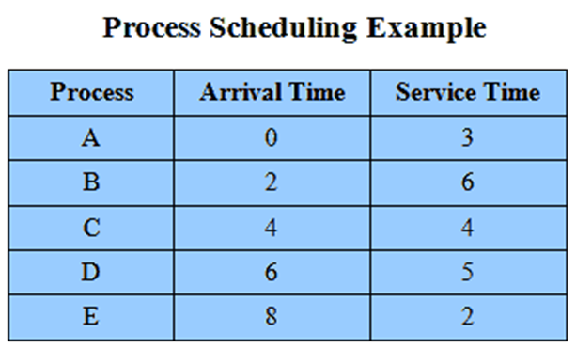
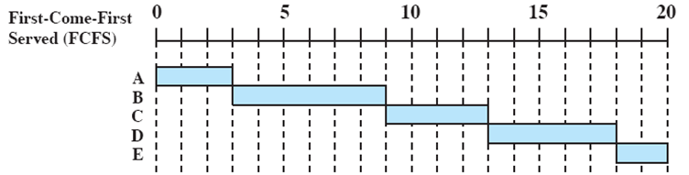
FCFS – Example # 1
Process | Arrival Time (AT) | Service Time (ST) | Finish Time (FT) | Turnaround Time (TAT)
A | 0 | 3 | 3 | 3
B | 2 | 6 | 9 | 7
C | 4 | 4 | 13 | 9
D | 6 | 5 | 18 | 12
E | 8 | 2 | 20 | 12
Gantt Chart
Gantt chart illustrates a process schedule.
TAT = FT - AT

Slide 80
FCFS – Example #1 solved
Gantt Chart
Process | Arrival Time (AT) | Service Time (ST) | Finish Time (FT) | Turnaround Time (TAT)
A | 0 | 3 | 3 | 3
B | 2 | 6 | 9 | 7
C | 4 | 4 | 13 | 9
D | 6 | 5 | 18 | 12
E | 8 | 2 | 20 | 12
TAT = FT - AT

Slide 81
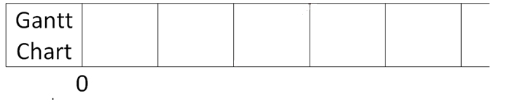
FCFS – Example # 2
Process | Arrival Time (AT) | Service Time (ST) | Finish Time (FT) | Turnaround Time (TAT) | Waiting Time | Response Time
P1 | 0 | 2
P2 | 1 | 2
P3 | 5 | 3
P4 | 6 | 4
TAT = FT – AT
Waiting Time = TAT – Burst time
Response time = The time at which the process gets CPU for the first time - AT

Slide 82
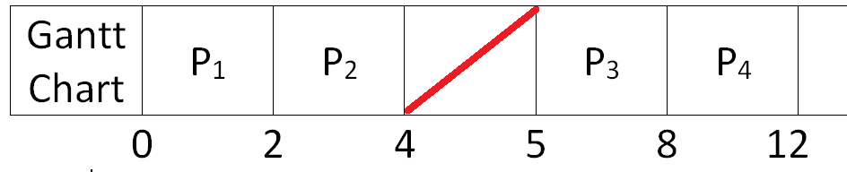
FCFS – Example # 2
Process | Arrival Time (AT) | Service Time (ST) | Finish Time (FT) | Turnaround Time (TAT) | Waiting Time | Response Time
P1 | 0 | 2 | 2 | 2 | 0 | 0
P2 | 1 | 2 | 4 | 3 | 1 | 1
P3 | 5 | 3 | 8 | 3 | 0 | 0
P4 | 6 | 4 | 12 | 6 | 2 | 2
TAT = FT – AT
Waiting Time = TAT – Burst time
Response time = The time at which the process gets CPU for the first time – AT
Average WT : WT of all process / #process

Slide 83

FCFS – Example # 3
Process | Arrival Time (AT) | Service Time (ST)
P1 | 1 | 24
P2 | 0 | 7
P3 | 2 | 13
P4 | 4 | 4
TAT = FT – AT
Waiting Time = TAT – Burst time
Response time = The time at which the process gets CPU for the first time - AT
Process | Arrival Time (AT) | Service Time (ST) | Finish Time (FT) | Turnaround Time (TAT) | Waiting Time | Response Time
P2 | 0 | 7
P1 | 1 | 24
P3 | 2 | 13
P4 | 4 | 4

Slide 84
FCFS – Example # 4
Process | Arrival Time (AT) | Burst Time (BT)
P1 | 0 | 7
P2 | 0 | 4
P3 | 0 | 2
P4 | 0 | 5
TAT = FT – AT
Waiting Time = TAT – Burst time
Response time = The time at which the process gets CPU for the first time - AT
Process | Arrival Time (AT) | Service Time (ST) | Finish Time (FT) | Turnaround Time (TAT) | Waiting Time | Response Time
P1 | 0 | 7
P2 | 0 | 4
P3 | 0 | 2
P4 | 0 | 5

Slide 85
FCFS
 Poor in performance as average wait time is high.
 A short process may have to wait a very long time before it can execute.
 Favors CPU-bound processes (mostly use processor) over I/O-bound processes.
I/O processes must wait until CPU-bound process completes

Slide 86



Shortest Job First (SJF) or Shortest Job Next (SJN) or Shortest Process Next (SPN)
Schedule process with the shortest burst time.
FCFS for same burst time.
Best approach to minimize waiting time.
2 variants
Non-preemptive – the process continues to execute until its completion
SJF with preemption – the process may get preempted when a new process arrives.
The processer should know in advance how much time process will take.
SJF Non-preemptive

Slide 87



SJF without preemption
Scheduler chooses P1 as it has arrived at 0 time instant.
After executing P1, scheduler has 3 options – P2, P3, P4 and it picks P4 having shortest burst time.
Notes:
- Nonpreemptive policy in which the process with the shortest expected processing time is selected next
- A short process will jump to the head of the queue
- Possibility of starvation for longer processes
- One difficulty is the need to know, or at least estimate, the required processing time of each process
- If the programmer’s estimate is substantially under the actual running time, the system may abort the job

Slide 88



SJF – without preemption
Process Number | Arrival time | Burst time | Completion time | TAT | Waiting time | Response time
P₁ | 0 | 7 | 7 | 7 | 0 | 0
P₂ | 2 | 4 | 14 | 12 | 8 | 8
P₃ | 4 | 2 | 10 | 6 | 4 | 4
P₄ | 7 | 1 | 8 | 1 | 0 | 0
Notes:
Gantt chart illustrates a process schedule.

Slide 89


SJF OR SPN
(without preemption)
Process Number | Arrival time | Burst time | Completion time | TAT | Waiting time
A | 0 | 3 | 3 | 3 | 0
B | 2 | 6 | 9 | 7 | 1
C | 4 | 4 | 15 | 11 | 7
D | 6 | 5 | 20 | 14 | 9
E | 8 | 2 | 11 | 3 | 1

Slide 90
SJF
Optimal – Minimum average wait time
Average response time decreases
 Not practical: difficult to predict burst time
 Long jobs starve
 Not suitable for timesharing or transaction processing due to no preemption

Slide 91

SJF with preemption – Shortest Remaining Time First (SRTF)
Preemptive version of SPN / SJF
Scheduler always chooses the process that has the shortest expected remaining processing time
If a new process arrives with a shorter burst time than remaining time of current process, then schedule new process.
$$if \left( NewProcess_{burstTime}<CurrentProcess_{remainingTime}\right)$$
$$Schedule New Process$$
Further reduces average waiting time and average response time.
Give superior turnaround time performance to SPN because a short job is given immediate preference to a running longer job
Turnaround time (TAT) means the amount of time taken to complete a process or fulfill a request.
Notes:
- Risk of starvation of longer processes
- Still depends on having accurate service time estimates.

Slide 92







SRTF
P / RT | RT | P / RT | RT | P / RT | RT | P / RT | RT

Slide 93



SRTF
P | AT | BT | CT | TAT | WT | RT
P1 | 0 | 7 | 14 | 14 | 7 | 0
P2 | 2 | 4 | 6 | 4 | 0 | 0
P3 | 4 | 2 | 8 | 4 | 2 | 2
P4 | 7 | 1 | 9 | 2 | 1 | 1
Q
P / RT | RT | P / RT | RT | P / RT | RT | P / RT | RT

Slide 94

P / RT | RT | P / RT | RT | P / RT | RT | P / RT | RT
SRTF (SJF with preemption)
Process | Arrival time | Burst time | Finish time | TAT | Waiting time | Response time
A | 0 | 3 | 3 | 3 | 0 | 0
B | 2 | 6 | 15 | 13 | 7 | 1
C | 4 | 4 | 8 | 4 | 0 | 0
D | 6 | 5 | 20 | 14 | 9 | 9
E | 8 | 2 | 10 | 2 | 0 | 0

Slide 95

Round Robin
Run process for a time slice then move back to ready queue; next job is selected on a FCFS basis.
Uses preemption based on a clock.
A clock interrupt is generated at periodic intervals.
Also known as time slicing because each process is given a slice of time before being preempted.
Principal design issue is the length of the time quantum, or slice, to be used.
 Its relative treatment of processor-bound and I/O-bound processes.
 More context switch overhead.
Notes:
Particularly effective in a general-purpose time-sharing system or transaction processing system
- A straightforward way to reduce the penalty that short jobs suffer with FCFS is to use preemption based on a clock. The simplest such policy is round
robin.
- A clock interrupt is generated at periodic intervals. When the interrupt occurs, the currently running process is placed in the ready queue, and the next
ready job is selected on a FCFS basis.
With round robin, the principal design issue is the length of the time quantum, or slice, to be used. If the quantum is very short, then short processes will move through the system relatively quickly. On the other hand, there is processing overhead involved in handling the clock interrupt and performing the scheduling and dispatching function. Thus, very short time quanta should be avoided.
Drawback
Its relative treatment of processor-bound and I/O-bound processes.
Generally, an I/O-bound process has a shorter processor burst than a processor-bound process.
If there is a mix of processor-bound and I/O-bound processes, then the following will happen:
An I/O-bound process uses a processor for a short period and then is blocked for I/O; it waits for the I/O operation to complete and then joins the ready queue.
A processor-bound process generally uses a complete time quantum while executing and immediately returns to the ready queue.
Thus, processor-bound processes tend to receive an unfair portion of processor time, which results in poor performance for I/O-bound processes, inefficient use of I/O devices, and an increase in the variance of response time.

Slide 96
Round Robin
Round robin is a pre-emptive algorithm
The CPU is shifted to the next process after fixed interval time, which is called time quantum/time slice.
The process that is preempted is added to the end of the queue.
Time slice should be minimum, which is assigned for a specific task that needs to be processed. However, it may differ OS to OS.
Notes:
Particularly effective in a general-purpose time-sharing system or transaction processing system
- A straightforward way to reduce the penalty that short jobs suffer with FCFS is to use preemption based on a clock. The simplest such policy is round
robin.
- A clock interrupt is generated at periodic intervals. When the interrupt occurs, the currently running process is placed in the ready queue, and the next
ready job is selected on a FCFS basis.
With round robin, the principal design issue is the length of the time quantum, or slice, to be used. If the quantum is very short, then short processes will move through the system relatively quickly. On the other hand, there is processing overhead involved in handling the clock interrupt and performing the scheduling and dispatching function. Thus, very short time quanta should be avoided.
Drawback
Its relative treatment of processor-bound and I/O-bound processes.
Generally, an I/O-bound process has a shorter processor burst than a processor-bound process.
If there is a mix of processor-bound and I/O-bound processes, then the following will happen:
An I/O-bound process uses a processor for a short period and then is blocked for I/O; it waits for the I/O operation to complete and then joins the ready queue.
A processor-bound process generally uses a complete time quantum while executing and immediately returns to the ready queue.
Thus, processor-bound processes tend to receive an unfair portion of processor time, which results in poor performance for I/O-bound processes, inefficient use of I/O devices, and an increase in the variance of response time.

Slide 97

Round Robin

Slide 98




Round Robin
Notes:
Particularly effective in a general-purpose time-sharing system or transaction processing system
- A straightforward way to reduce the penalty that short jobs suffer with FCFS is to use preemption based on a clock. The simplest such policy is round
robin.
- A clock interrupt is generated at periodic intervals. When the interrupt occurs, the currently running process is placed in the ready queue, and the next
ready job is selected on a FCFS basis.
With round robin, the principal design issue is the length of the time quantum, or slice, to be used. If the quantum is very short, then short processes will move through the system relatively quickly. On the other hand, there is processing overhead involved in handling the clock interrupt and performing the scheduling and dispatching function. Thus, very short time quanta should be avoided.
Drawback
Its relative treatment of processor-bound and I/O-bound processes.
Generally, an I/O-bound process has a shorter processor burst than a processor-bound process.
If there is a mix of processor-bound and I/O-bound processes, then the following will happen:
An I/O-bound process uses a processor for a short period and then is blocked for I/O; it waits for the I/O operation to complete and then joins the ready queue.
A processor-bound process generally uses a complete time quantum while executing and immediately returns to the ready queue.
Thus, processor-bound processes tend to receive an unfair portion of processor time, which results in poor performance for I/O-bound processes, inefficient use of I/O devices, and an increase in the variance of response time.

Slide 99


Round Robin
Process | Arrival time | Burst time | Finish time | TAT | Waiting time | Response time
P1 | 0 | 5 | 14 | 14 | 9 | 0
P2 | 0 | 4 | 12 | 12 | 8 | 2
P3 | 0 | 2 | 6 | 6 | 4 | 4
P4 | 0 | 3 | 13 | 13 | 10 | 6

Slide 100

Time quantum (q) = 4
READY QUEUE

Slide 101

Time quantum (q) = 2
Process | AT | BT | FT | TAT | WT | RT
A | 0 | 3 | 5
B | 2 | 6
C | 4 | 4
D | 6 | 5
E | 8 | 2
A
B
A
C
B
D
C
E
B
D
D
B
A
C
B
D
C
E
B
D
READY QUEUE

Slide 102


Slide 103


Slide 104
Unit 3 – Introduction to Operating System & Process Management
Operating system
Kernel types and functionalities
System call
Process – creation, termination, states, PCB
Threads – introduction; types; models;
Uniprocessor CPU Scheduling
FCFS, SJF, SRTF, Round Robin

